Slide 1

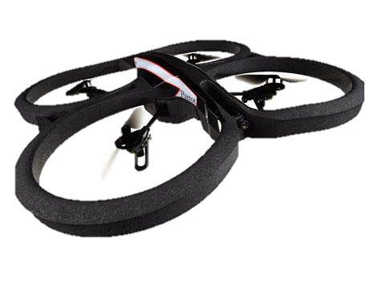











$$z$$
$$\left(x_{1},y_{1},z_{1}\right)$$
$$y$$
$$x$$
$$\left\langle W\right\rangle$$
$$α$$
$$ρ$$
$$ρ\sin{α}$$
$$β$$
$$ρ\sin{β}$$
$$(x_{2},y_{2},z_{2})$$

Slide 2



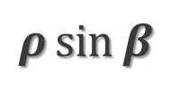





$ρ$ $\sin{α}$
$$ρ\sin{β}$$
$$(x_{c},y_{c},z_{c})$$
$$ρ$$
$$β$$
$$α$$
$$\left(x,y,z\right)$$
$$\left\langle W\right\rangle$$

